Slide 1
S4 Bird Migration
By: Matt Coulter, Preston Due, Jenna Kill, Mark Hadley, Derek Miller, David Mortland, Andy Ruckman, Casey Ruckman, Sam Zack, & Yuhang Zou

Slide 2
Original Plan
Temperature, barometric pressure, humidity, and the strength of the magnetic field
Migration altitudes
3 launches per day, 3 launches per night during migration season
Birds would have to be tracked during launches
Good experiments only test one variable
Allows us to come to a conclusion with a realistic number of launches

Slide 3
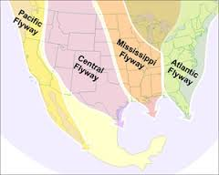
Hypothesis
We hypothesize that the magnitude of the Earth’s magnetic field does not significantly correlate with a change in altitude relative to the Earth’s surface.
Therefore, the altitude at which birds migrate at IS NOT determined by the strength of the Earth’s magnetic field

Slide 4
How Can We Determine Success?
If our data shows a steady magnetic field strength with increasing altitude, our hypothesis is correct
If our data shows a decrease in magnetic field strength as altitude increases, then the Earth’s magnetic field strength may play a role in determining the altitude at which birds migrate.
This would deem our hypothesis incorrect

Slide 5
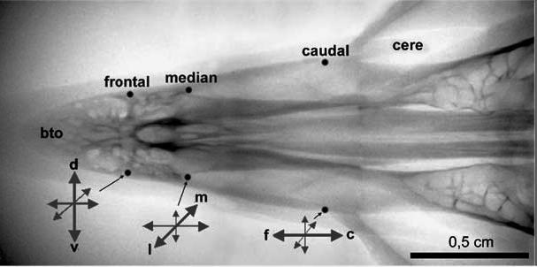
Background Info
Two Main Theories
Cryptochromes
proteins in birds eyes allow them to “see” Earths magnetic field lines
Magnetite
Allows the bird to detect if it’s going north or south
Notes:
Matt And Mark
First theory: Cryptochromes, a light sensitive protein in the bird’s eye that allow them to see increasing or decreasing variations of light depending on their orientation to the magnetic field. However this system of navigation can create some problems once the bird gets closer to the poles or the equator with the equator field lines being horizontal and the pole lines being vertical. This makes it impossible for the bird to pick the correct direction. The bird has other means of finding their way to help them though such as magnetite, the stars, the sun, etc. We have found through our research that birds have one and/or two senses that help them in detecting fields

Slide 6
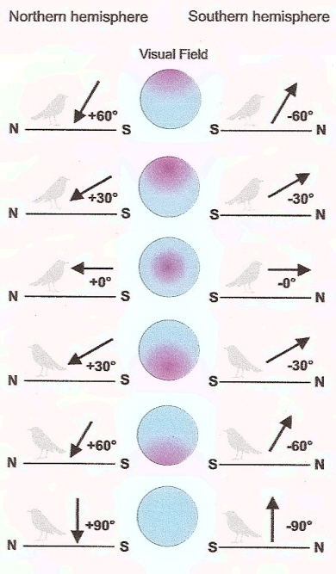
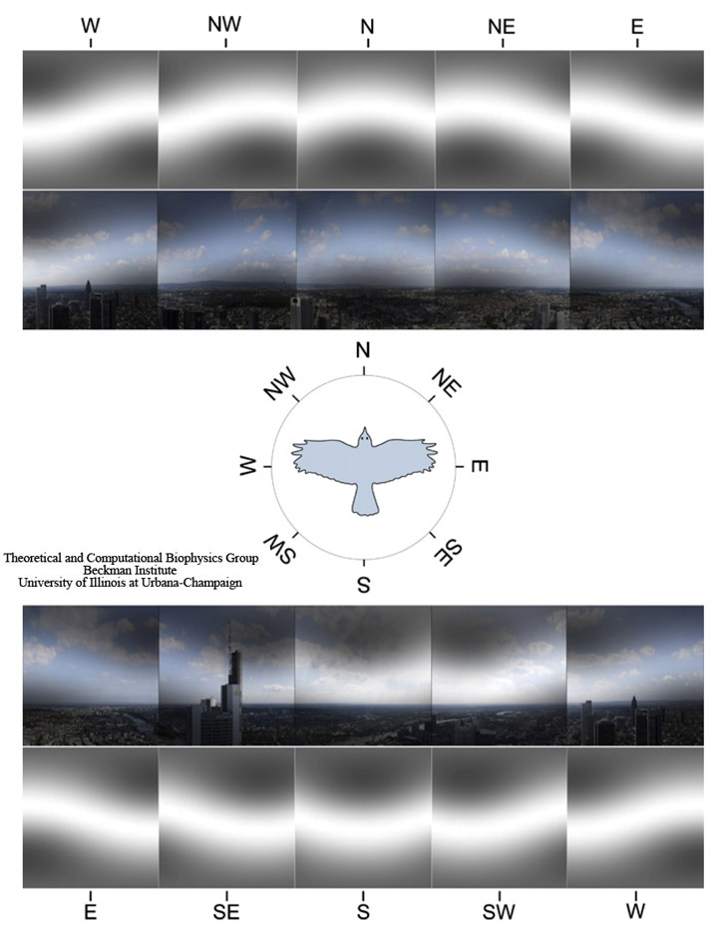
Theory 1- Cryptochromes
Notes:
Matt
This theory states that a light sensitive protein in the bird’s eye lets them see increasing/decreasing variations of light depending on their orientation to the magnetic field.

Slide 7
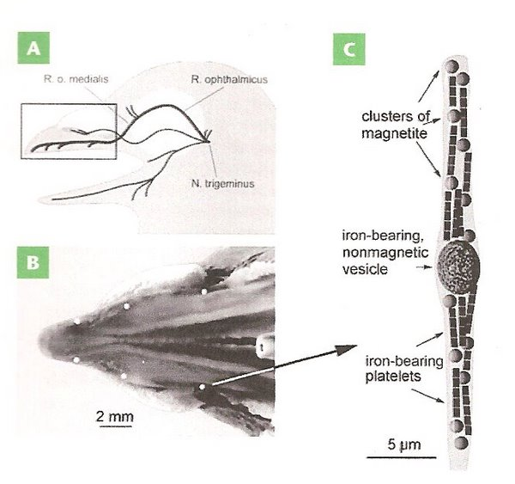
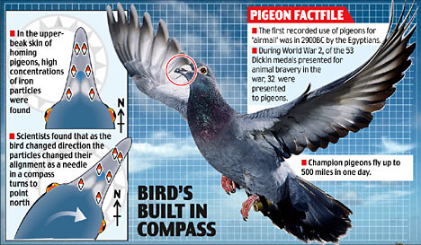
Second Theory: Magnetite
Notes:
Mark
This theory states that birds have a piece of magnetite in their beaks that allows them to detect the polarity of the magnetic field.

Slide 8
Rocket Design and Info
There are four compartments on our rocket:
Nosecone holds payload.
Second stage-holds parachute.
Coupler holds flight computer and charges for parachute.
Inside the Motor mount there is carbon fiber lining also has 3 fiberglass fins.

Slide 9
Rocket Design Cont.
The Rocket will reach anywhere from 6000-7000 feet high with our K1050 motor.
It is made of fiberglass and can be outfitted with anywhere from a K-M class motor.
Upon reaching apogee the bottom charge goes off, which will open the main 60” parachute.
Two seconds after apogee the top charge will go off which will eject the nose cone to come down on a 60” parachute, to hopefully reach a 15 minute hangtime. (horizon to horizon)

Slide 10
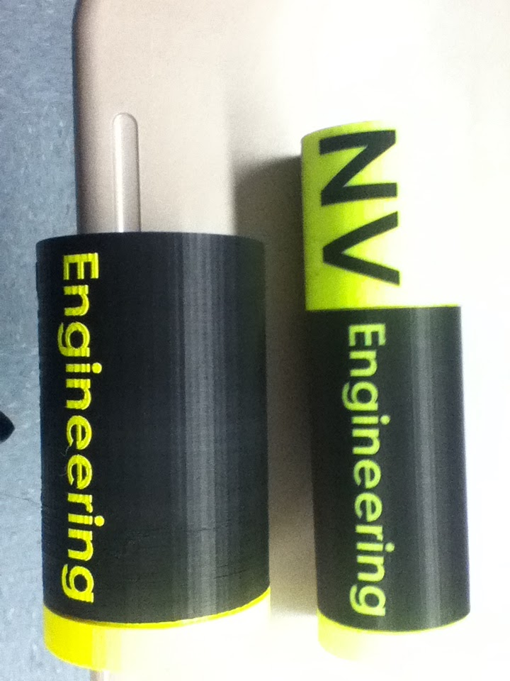
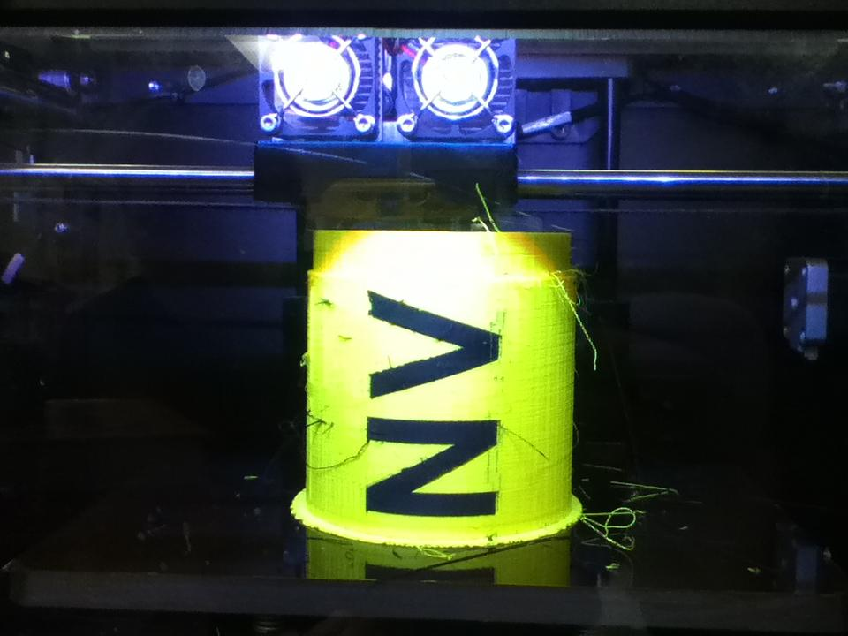
3D Printing
Constructing the Payload Case
Vertical assembly design on SolidWorks
Redesign and Redrafts
4 total versions were made
Notes:
Ruckman
For constructing a payload case, our group designed a vertically assembled, 3D printed case
In the end, we have gone through 4 generations of cases to finally get our desired size and features

Slide 11
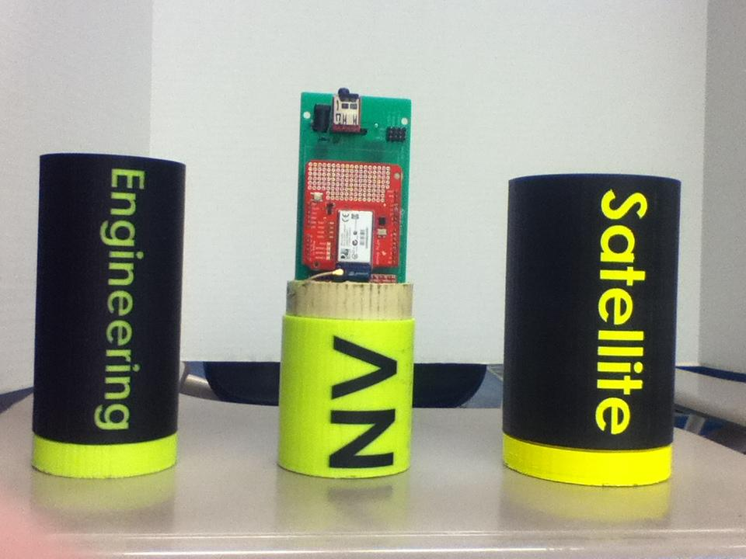
Programming
S4 Satellite Programming
Arduino IDE Libraries
WPA Modifications
Analysis of Data
Export to Excel using functions and equations
On-Board Flight Computer
Programmed to deploy at safe altitude
Notes:
Casey
We programmed the S4 satellite using the provided Arduino IDE libraries with slight modifications to allow WPA connectivity
For post data analysis we utilized the function ability of Excel to give us an easy way to draw conclusions with our gathered data
Along with programming the S4 Satellite, we had to program our flight computer for our desired ejection events to ensure a safe return of our rocket and satellite

Slide 12
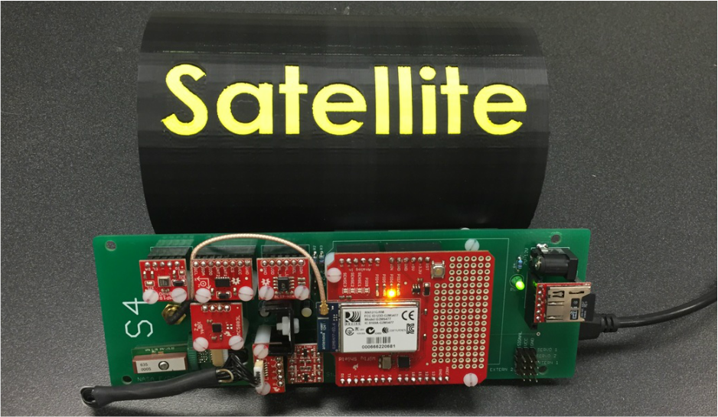
Testing and Data
Hypothesis Testing:
Magnetometer
Thermometer
Barometric Pressure
Humidity Gauge
Data from apogee to ground
Testing the altimeter with the vacuum chamber
Notes:
Derek
with the devices we installed on the S4 arduino board such as the magnetometer, barometer, temperature gauge, and humidity reader.
Once our rocket reaches apogee it will be recording data until it reaches the ground

Slide 13
Challenges overcame
Challenge:
Drone/satellite issue
3d printer
Raising funds
Transportation of materials

Slide 14
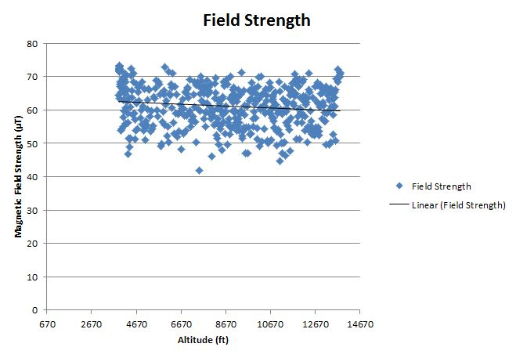
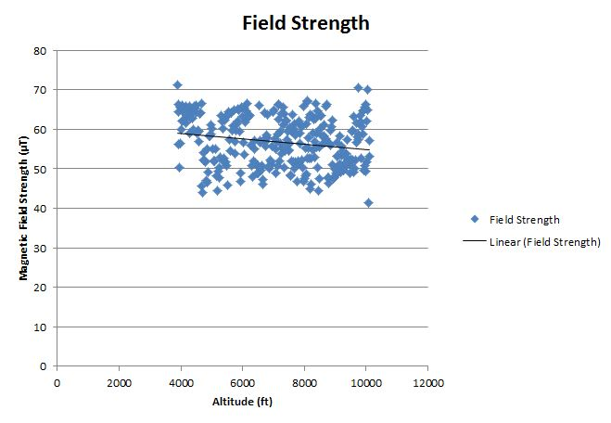
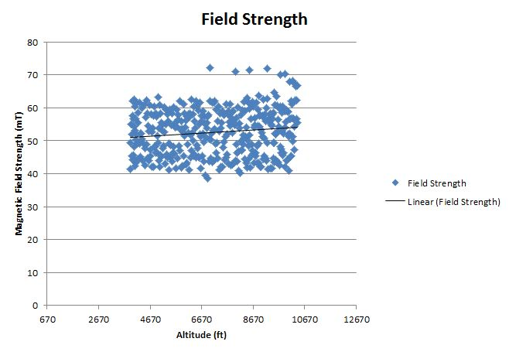
Results
Notes:
Casey

Slide 15
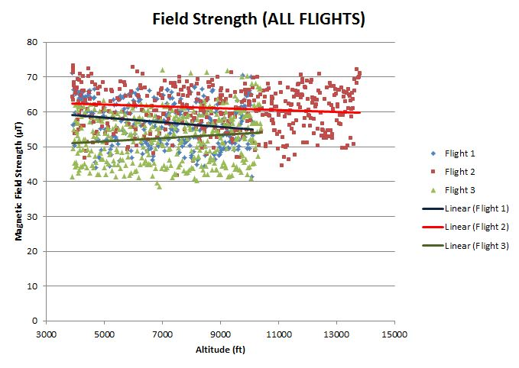
Final Results
Notes:
prestin

Slide 16
Conclusion
There was no significant correlation between altitude and magnetic field strength
Based on our experimental data, our hypothesis was correct
Magnetic field strength does not play a role in determining the altitude at which birds migrate
Altitude must be determined by temperature, barometric pressure, and humidity
Notes:
Mark and Matt

Slide 17
Support
From the data we collected:
We saw no upward or downward trend in Magnetic field as altitude increased
This means that the magnetite and cryptochromes in the birds would detect no changes in the magnetic field as altitude increased, based on our experimental values
Notes:
Mark and Matt

Slide 18
S4 Outreach
Community Spotlights
NBC 24 News Highlight
Two Blade Newspaper Articles
Our Town Sylvania Articles
Rockets-On-The-Hill Recognition
5 stations on Cumulus Radio Stations
Northview Engineering website:
http://www.northviewengineering.weebly.com/
Notes:
Jenna

Slide 19
Company Sponsors
Several Companies have gotten involved in their own unique ways
Contributions:
Materion-
Social Media Promotion
Financial Support
FHEA (Facilities Healthcare Engineering Associations)-
Financial Support
Sportszone-
Jackets and Shirts
Mark’s Ark and Black Swamp Bird Observatory
Research and Bird Talks

Slide 20
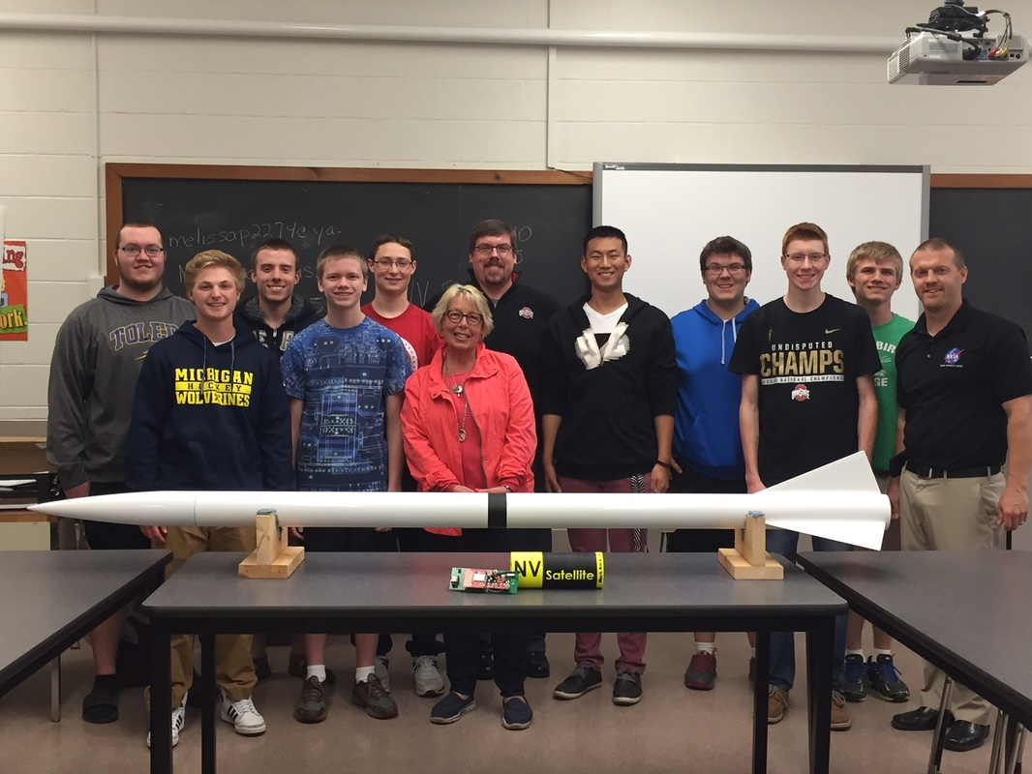
Individual Sponsors
Many Individuals sponsored our project as well:
Mr. LeRight - Helping Build the Entire Rocket (Pyramid Sprinklers)
Captain Latta-a captain from the United States Air Force came down four hours to inform us about the technology we will be using as they have used this technology before
Keiser family- The Entire Reason we are here

Slide 22
Work Cited
http://people.eku.edu/ritchisong/birdbrain2.html
http://www.innovations-report.com/html/reports/life_sciences/report-29248.html
http://rsif.royalsocietypublishing.org/content/7/Suppl_2/S193
http://www.cell.com/current-biology/abstract/S0960-9822%2811%2900114-X
http://www.ncbi.nlm.nih.gov/pmc/articles/PMC2844001/
http://www.ncbi.nlm.nih.gov/pmc/articles/PMC3552369/

Slide 23
Work Cited
"Bird Brain II." Bird Brain II. Eastern Kentucky University, n.d. Web. 15 June 2015.
Liedvogel, Miriam, and Henrik Mouritsen. "Cryptochromes—a Potential Magnetoreceptor: What Do
We Know and What Do We
Want to Know?" Journal of the Royal Society Interface. The Royal Society, n.d. Web. 15 June
2015.
Trulove, Susan. "Forum for Science, Industry and Business." Innovations Report. Siemens, n.d.
Web. 15 June 2015.
Wiltschko, R., and W. Wiltschko. "The Magnetite." Journal of Comparative Physiology. A,
Neuroethology, Sensory, Neural, and
Behavioral Physiology. Springer-Verlag, n.d. Web. 15 June 2015.
Wu, Le-Qing, and J. David Dickman. "Magnetoreception in an Avian Brain in Part Mediated by Inner
Ear Lagena." Cell Press.
N.p., n.d. Web. 15 June 2015.

