Slide 1
Establishing a Model for the Variability of Wind Speed
by Team Curry: Ajit Assi, Steve Silva, Sahil Rikhi, Lynn Tran, Eri Kitagawa, Anthony Huynh, Sean Nguyen, Jose Santana

Slide 2
Hypothesis
What is the variability of wind speeds and does it affect the descent of a rocket?
Does our model accurately predict the variability? Can we successfully use it to predict the effects on future descent?
With the Vaavud app, we can achieve our theoretical wind speed, while our model hopes to create the experimental wind speed
We can use both values to calculate our percent errors, which we will conclude accurate if under 10% .

Slide 3
Hypothesis (theoretical vs experimental)
We intend to create a wind speed model to represent our experimental value of wind speed
so we will be measuring factors :
(Wind Speed) -We found that HPT was inversely proportionate to Altitude
A = Altitude
H = Humidity
P= Pressure
T = Temperature

Slide 4
Process to Success
Build S4 payload and a rocket big enough to hold S4 sensor and iPhone inside payload section
Launched at Snow Ranch to test high-powered rocket and sensors
The rocket went ballistic, leading to skewed results from the payload
Used another group’s data to attempt to correlate the data
Not able to observe the wind speeds without Vaavud

Slide 5
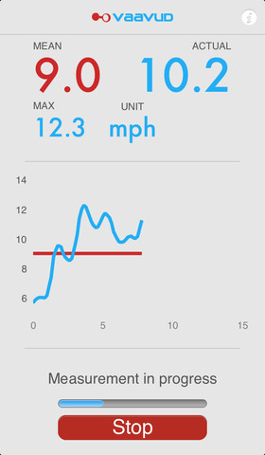
Build/Test Plan
Using the Vaavud wind meter to have the payload deploy in a way that allows it to read lateral wind speeds from 2-40 m/s
A prototype of the payload will be tested by dropping the payload from a designated height.
The payload nose cone should face down, gravity pulling on the sliding mechanism causes the outer tube to slide downwards revealing the cross section of the payload containing the wind-reading vaavud.
Initial design included the Iphone with the Vaavud to be mounted on the bottom of the top payload
If we mount the parachute lining the bulkhead, the strength of the parachute would decrease and the packaging of the parachute would be difficult and increases chances of error.

Slide 6
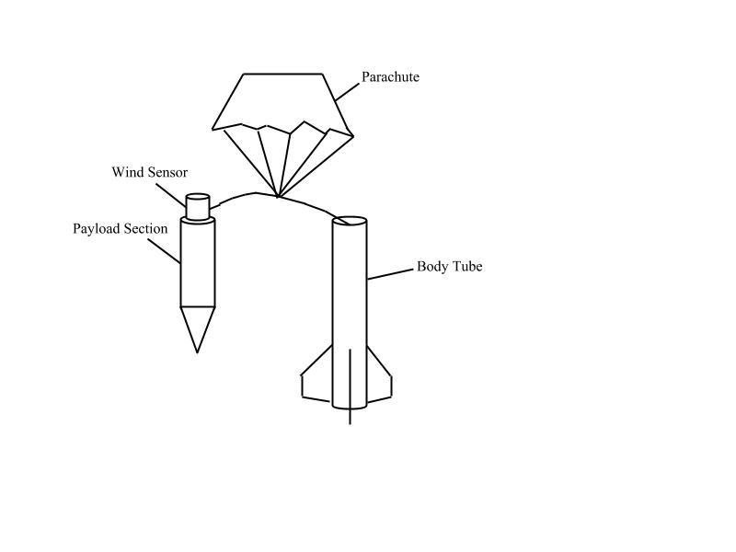
First design
This design would not work due to the parachute tugging on the payload during deployment, causing the Vaavud to collide with the booster section or becoming entangled in the parachute strings or shock cord.

Slide 7
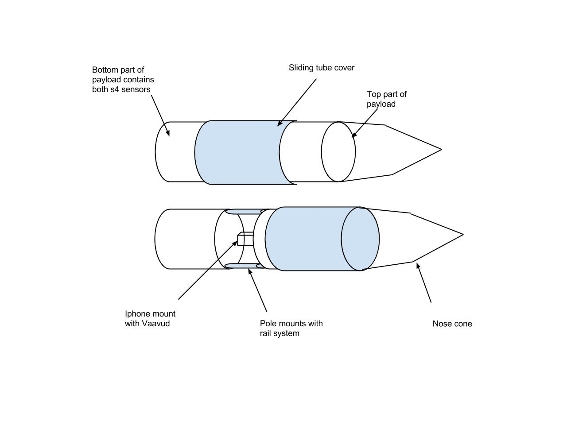
Finalized design
New design incorporates gravity
-gravity pulls down sliding tube cover along rail mounted pole mounts, revealing the Vaavud.
-Such design would allow us to test without the use of an actual rocket and motors; payload can be thrown from top of a building and data will be analyzed to test for effectiveness.
-S4 payloads will be side by side vertically in the bottom part of the payload

Slide 8
Data Analysis Plan
We chose to analyze temperature, humidity, and pressure compared with altitude to recognize their trends as the rocket ascends. With the trends recognized accurately instead of approximated by guess, we will compare the new data to wind data from the vaavud which we have not yet known.
Barometer GPS Thermostat Humidistat

Slide 9
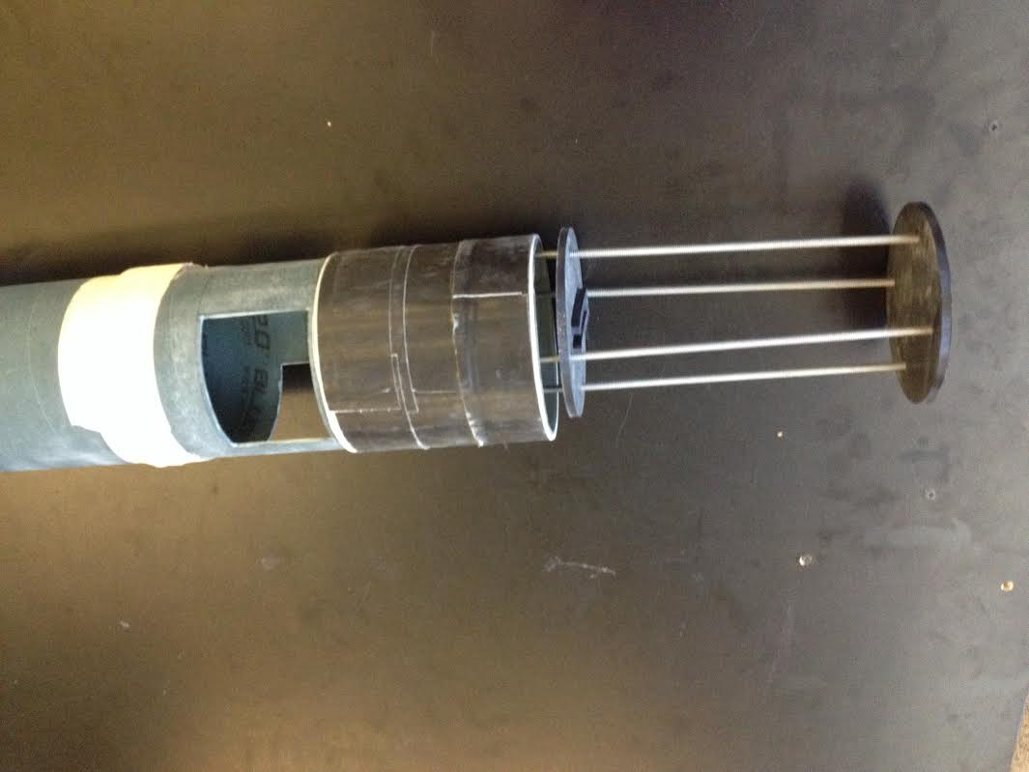

Slide 10
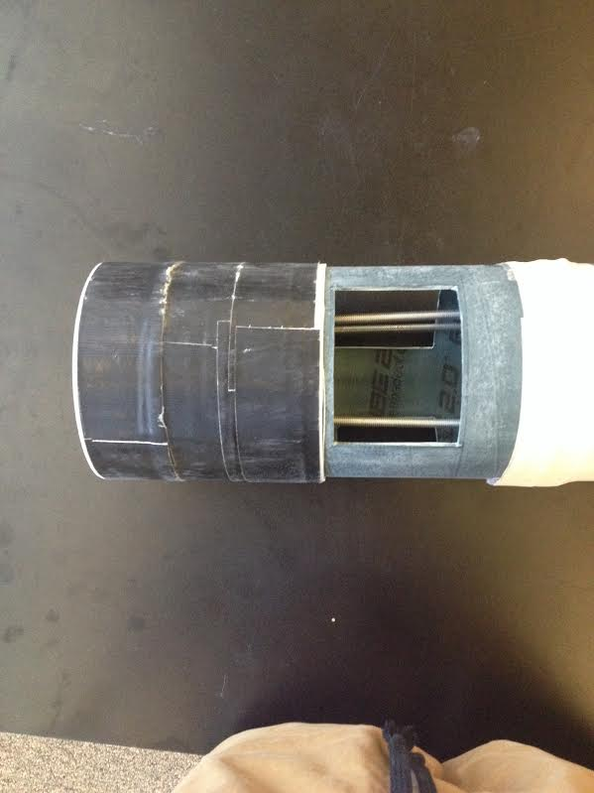

Slide 11
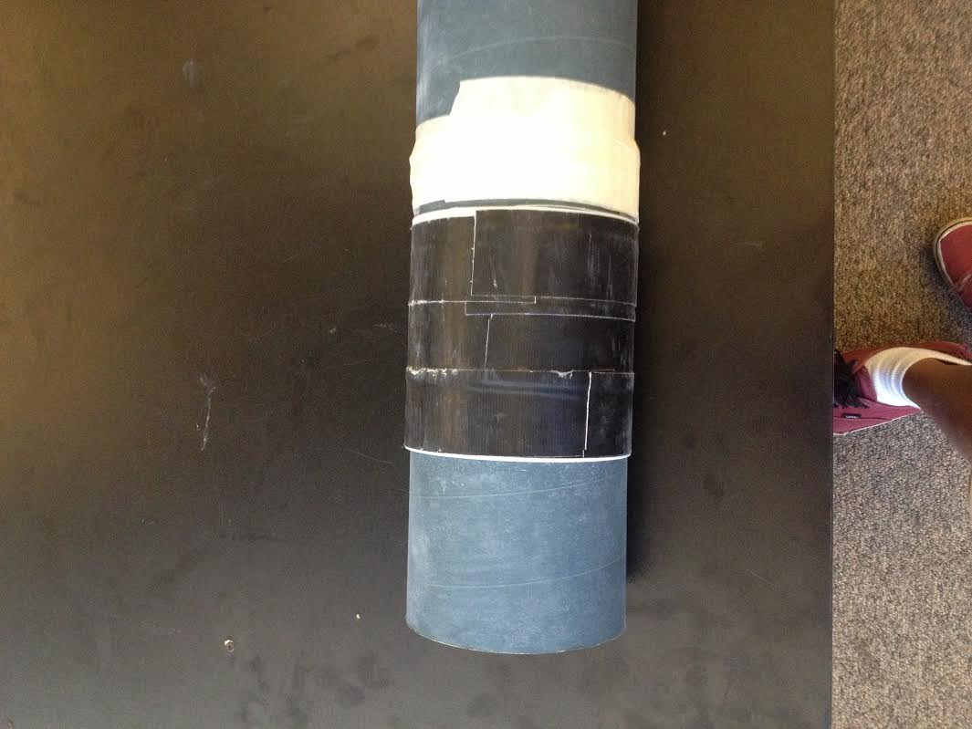

Slide 12
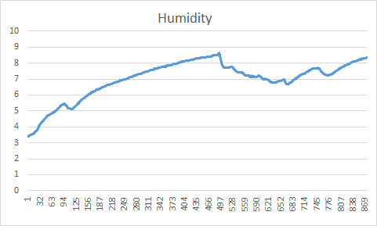
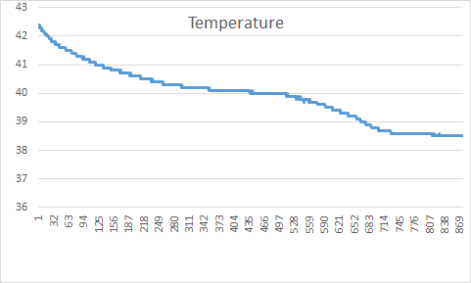

Slide 13
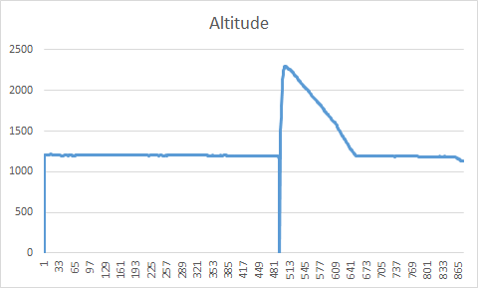
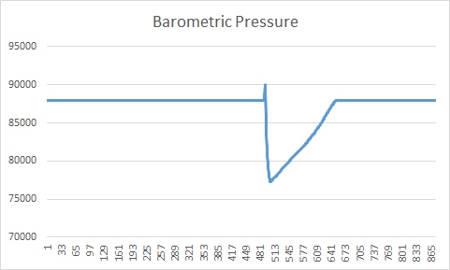

Slide 14
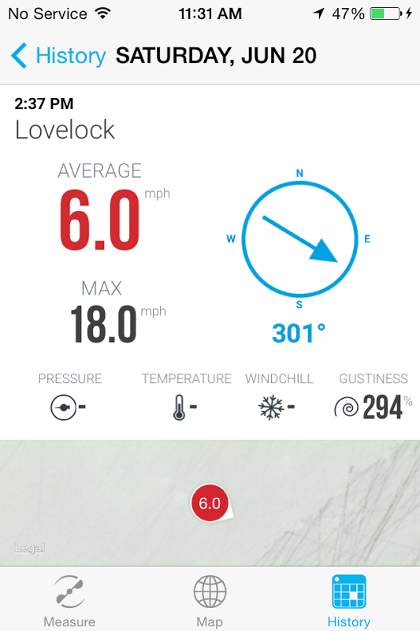
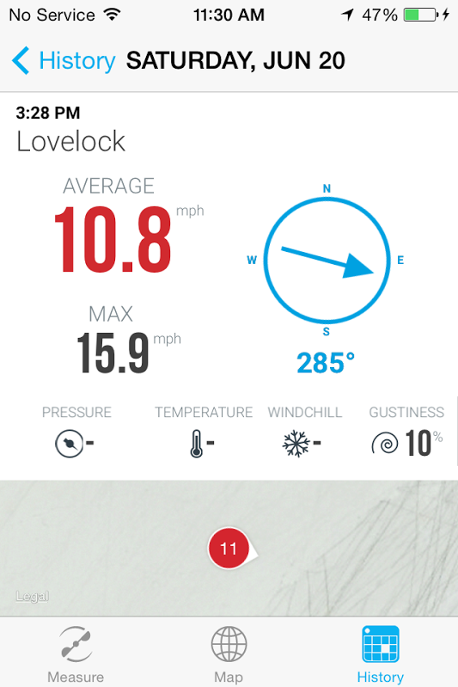
Ground Wind Speeds

Slide 15
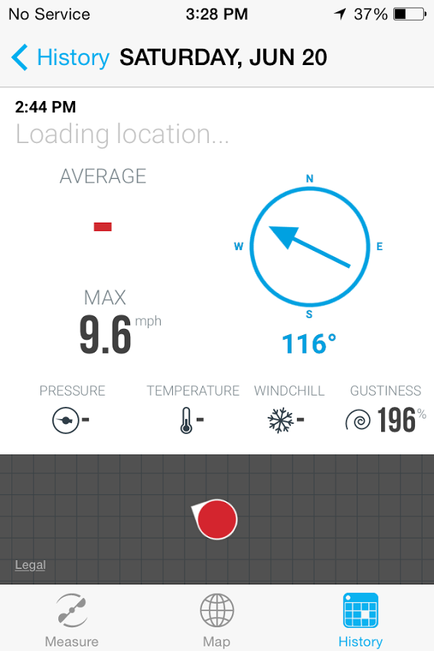
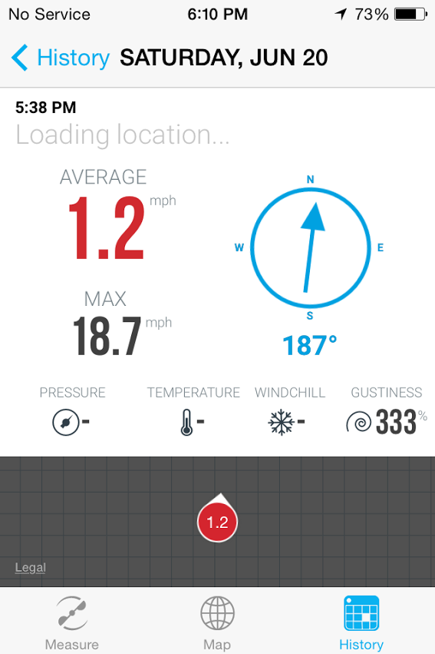
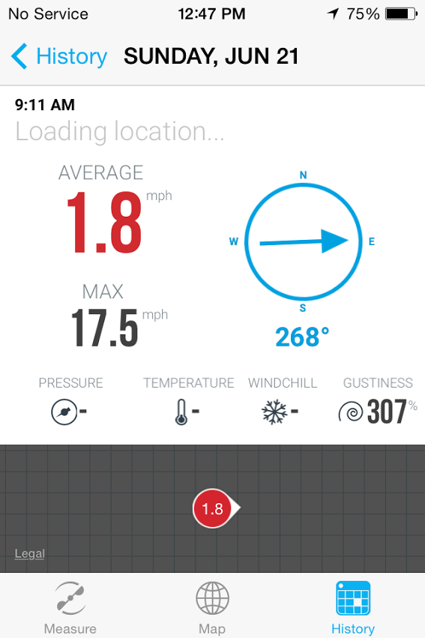
Flight 1 Flight 2 Flight 3

Slide 16
Conclusion
Even though we predicted that the wind speeds in the air would be slower, our Vaavud data shows that the max wind speeds of the air were actually faster.
Although there were many limitations to the Vaavud, many solutions opened up. First, we could have built our own anemometer that calculates the wind speed second by second. With our own anemometer, we would be able to remove the limitations the that Vaavud provided, and receive conclusive data.

Slide 18
Data Evaluation
Our data was very limited due to the fact that we were not able to observe the wind speeds directly without the graphs generated from the Vaavud. As a result, we were forced to analyze other factors during the launch to try and predict the wind speeds at varying altitudes. Without conclusive data of the wind speeds, the results of our data should not be completely trusted.

Slide 19
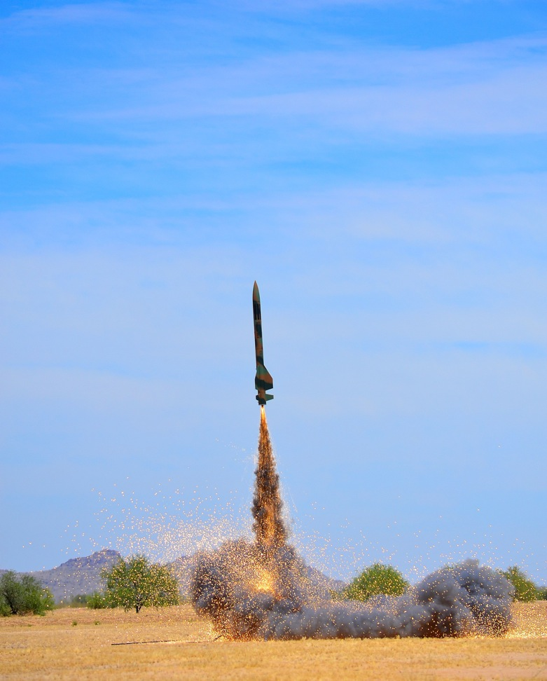
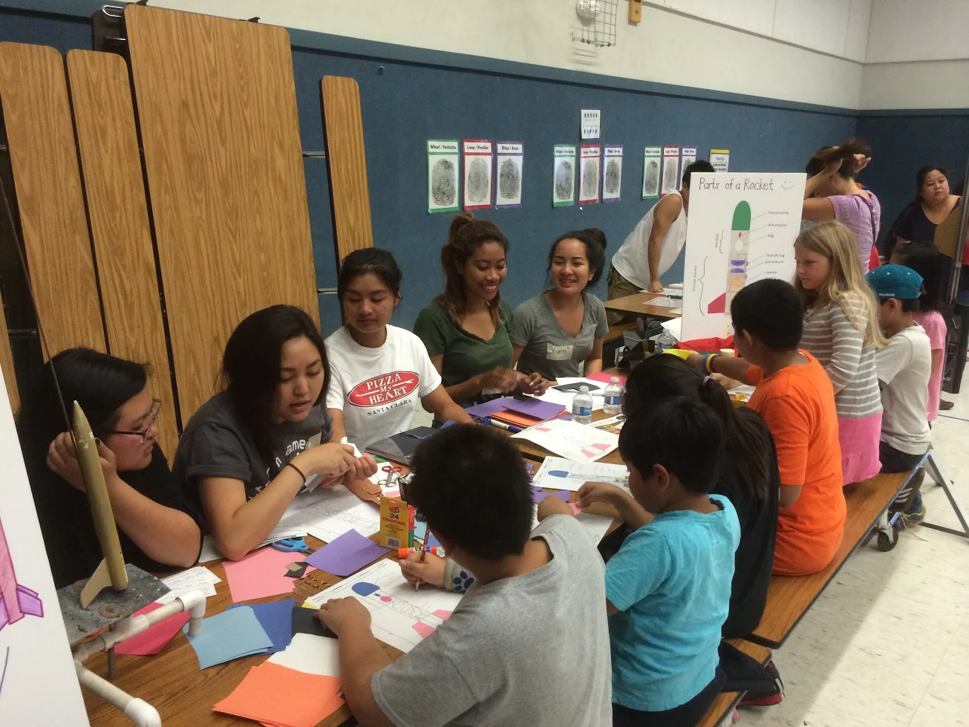
Science in the park : showed our rocket model to the peers and did some test flights with the model rocket # of people affected 200-300
Elementary Science Night: explained our rocket and did some demonstrations # of people affected 50-60

Slide 20
Take away from S4 experience-
As a team, we were able to learn a lot from this experience. This competition taught us how to solder, analyze data thoroughly, and think outside the box when it comes to rocket designs. Instead of the conventional rocket designs normally used for TARC, we had to design a rocket that could hold an iPhone and an S4 payload while having the Vaavud record data mid-flight.

Slide 21
Hypothesis (theoretical vs experimental)
Our equation to represent our experimental value of windspeed is :
A/(H * P * T)
so we will be measuring factors :
(Wind Speed) -We found that HPT was inversely proportionate to Altitude
A = Altitude
H = Humidity
P= Pressure
T = Temperature

