Slide 1
Atmospheric Effects
on Descent Rate
Josh Carloss
Darren Ko
Jordan Martin
Bryanna McLoy
Jocelyn Melgoza
Tyler Neca
Noah Radoye
Michael White

Slide 2
What Effects Descent Rate?
Hypothesis
Descent Rate and Air Density are inversely proportional
Air Density based on Temperature, Pressure, and Humidity
Descent Rate and parachute size are inversely proportional
Descent Rate and rocket mass are directly proportional
Goal - To create a formula that can be used to calculate the descent rate of the rocket based on the factors listed above.
Notes:
Bryanna
-Predictions based off of observations of TARC flights and research Inversely Proportional- as one goes up, the other goes down
Directly Proportional- as one goes up, the other goes up
Air Density
-Air pressure is directly proportional to Air Density
-Temperature is inversely proportional to Air Density
-Humidity is inversely proportional to Air Density
-Should be able to apply formula to other data sets
-Should be able to predict descent rate within a 15% error range

Slide 3
Descent Rate Formulas
Original (based on Predictions)
H = humidity
Air Density – T = temperature
E = elevation
Ap = atmospheric pressure
M = mass
P = parachute size
Dr = descent rate
Notes:
Descent Rate and Air Density are inversely proportional
Air Density based on Temperature, Pressure, and Humidity
Descent Rate and parachute size are inversely proportional
Descent Rate and rocket mass are directly proportional

Slide 4
Descent Rate Formula
Final formula (developed from data)
Descent Rate in meters per second (m/s)
M = Mass in kilograms (kg)
Para = Parachute diameter in meters (m)
T = average temperature in Celsius (C°)
P = average Air Pressure in Pascals ([kg*m/s^2]/m^2)
H = average relative humidity expressed as a decimal
Notes:
Air Density
-Air pressure is directly proportional to Air Density
-Temperature is inversely proportional to Air Density
-Humidity is inversely proportional to Air Density

Slide 5
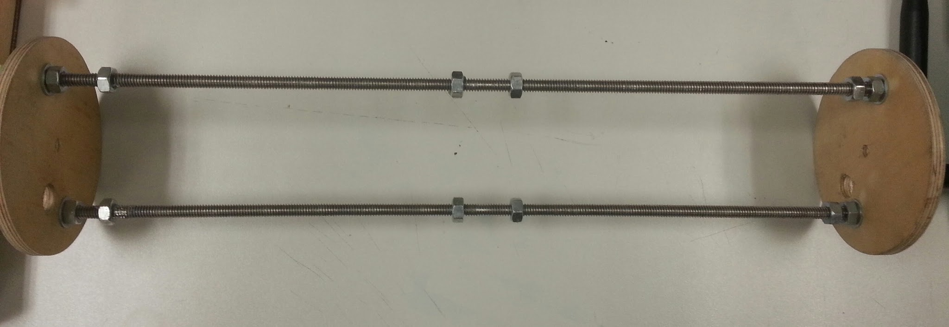
Build/Test Plan
Mounting the S4 sensors
2 sensors
Custom payload Rack
2 x ¼” rods,each 15” long with a bulkhead
S4 boards will be mounted between these two bulkheads
Notes:
2 sensors, in case 1 fails
custom fit for our rocket

Slide 6
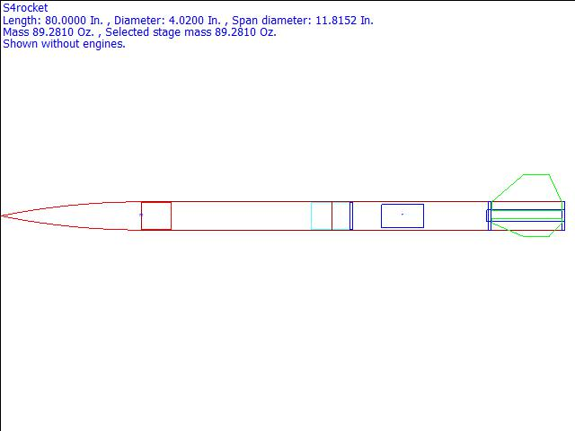
Build/Test Plan
Payload Section
4” Diameter, 1’11” long
20” ogive nose cone
Six pressure sensing holes
Booster Section
33” in length
outer diameter 4”
38mm motor mount
36in parachute
Notes:
We also used various other rockets provided to us
Multiple test beds

Slide 7
Data Measurement
To test this hypothesis…
Rocket Stats
Atmospheric Conditions:
Barometer
Temperature Sensor
Humidity Sensor
Sensors take data every second
Notes:
TYLER
Our equation calls for the mass of the rocket and parachute diameter, along with the average values of humidy, temperature, and pressure.
Barometer- Used to measure the pressure (Higher the Altitude lower the pressure)
Accelerometer- Used to measure the acceleration
GPS - Enables us to track the rocket using a GPS
Temperature - Used to measure the temperature
Humidity - Used to measure the Humidity

Slide 8
Data Analysis Plan
Data Analysis Procedure
Step 1 : Convert to Excel
Step 2 : Convert pressure to altitude (-8240ln(P)/101325)
Step 3 : Graph the altitude to find slope
Step 4 : Calculate theoretical descent rate
Step 5 : Calculate percent error
Notes:
1 – use S4 data manager to convert txt document to a CSV files which we can open in excel
2 – use this formula (-8240ln(P)/101325) to convert barometric pressure into altitude in meters
3- isolate the descent portion of the flight, from apogee to ground, and graph this selection and find the slope of this line
4- calculate the average values of pressure, humidity, and temperature and plug these values in along with the rocket’s mass and parachute diameter into the formula
5 –to determine if ourformula is valid. We want a 15% error range.
And now Darren and Michael will walk you through the formula

Slide 9
Descent Rate Formula
Final formula (developed from data)
Descent Rate in meters per second (m/s)
M = Mass in kilograms (kg)
Para = Parachute diameter in meters (m)
T = average temperature in Celsius (C°)
P = average Air Pressure in Pascals ([kg*m/s^2]/m^2)
H = average relative humidity expressed as a decimal
Notes:
Air Density
-Air pressure is directly proportional to Air Density
-Temperature is inversely proportional to Air Density
-Humidity is inversely proportional to Air Density

Slide 10
Finding the Constant
Altitude Via Pressure
m=-6.47m/s
Notes:
Take average weather values from each of the flights

Slide 11
Predicting Descent Rate
-Start with the formula
Notes:
Step 1- sub in variables
Step 2- Cancel Units
Step 3- calculate

Slide 12
Predicting Descent Rate
-Sub in the known Variables
Notes:
Step 1- sub in variables
Step 2- Cancel Units
Step 3- calculate

Slide 13
Predicting Descent Rate
-Cancel out the units and solve!
Notes:
Step 1- sub in variables
Step 2- Cancel Units
Step 3- calculate

Slide 14
Conclusion
Test 1- Charlie/Viper
5.1%
Test 2- Team 2/Maverick
18%
Test 3- Team 3/Steri
3.1%
Test 4- Team 1/Maverick
Program
Conclusions
Appilcable to multiple rockets
Need to calibrate prior to usage
Notes:
Test 2- possible air pressure sensor errors
Test name/rocket owner/ sensor name
Plug Ins: Actual: -4.488
3.2 kg percent error: 0.9%
‘0.91 M
40.89736
0.06255425
83123.54
Calibration methods:
Run Test flight
Float weather balloon
Check data from local airport

Slide 15
Team Experience
Prior S4
TARC
high powered rocketry
After S4
Soldering
Data Analysis Practice
Notes:
Our team consists of eight members, all of whom have participated in the TARC challenge
Many of our members have been designing, building, and flying rockets for multiple years, as well as collecting data on weather and the flight of each rocket
Most 4 year, 3 back to bak trips to nationals
Flew at Snow Ranch
Half oour team is level 1 certified
After gaining some basic soldering experience, our team has built three working S4 payloads
Our team first flew an S4 payload on October 18, 2014, yet unfortunately our payload did not collect any data due to a programming issue
The next time our team flew S4 payloads was on April 4, 2015 at Snow Ranch in Farmington, CA; our team flew two payloads and received data from both
Our team also spent time in class learning how to enter our data into a spreadsheet, graph it, and analyze it

Slide 16
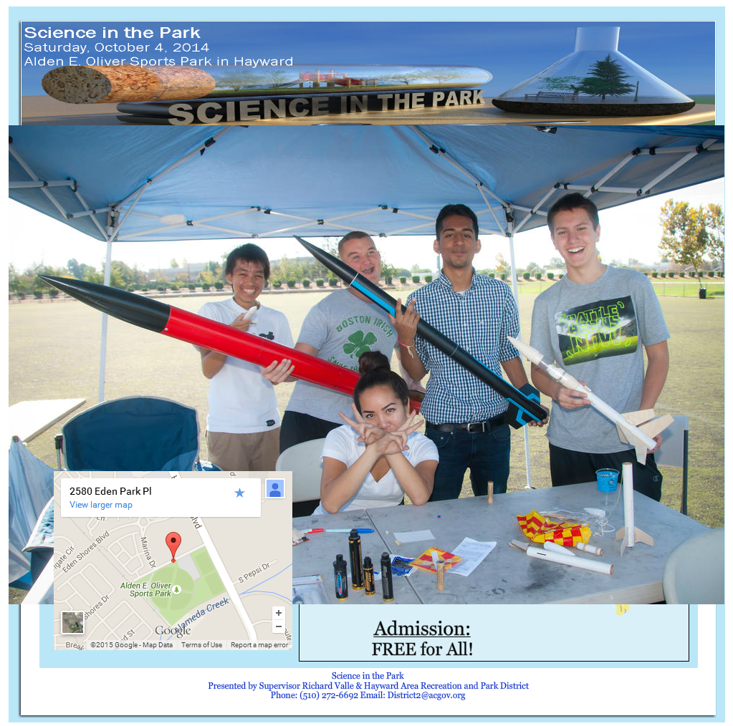
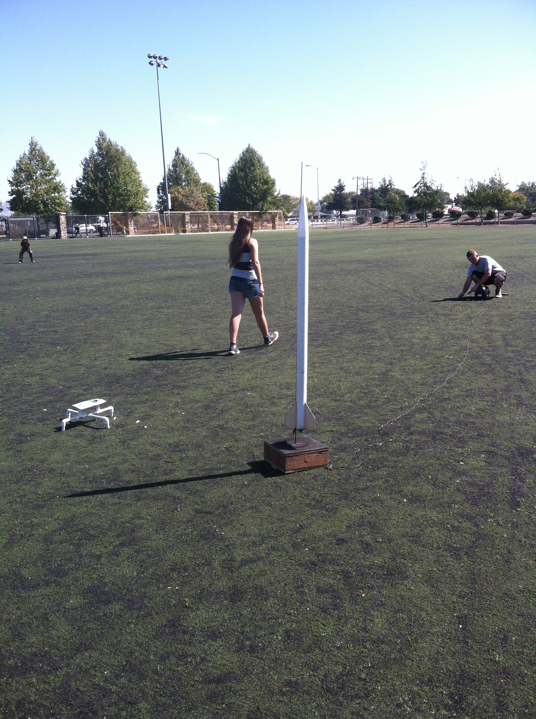
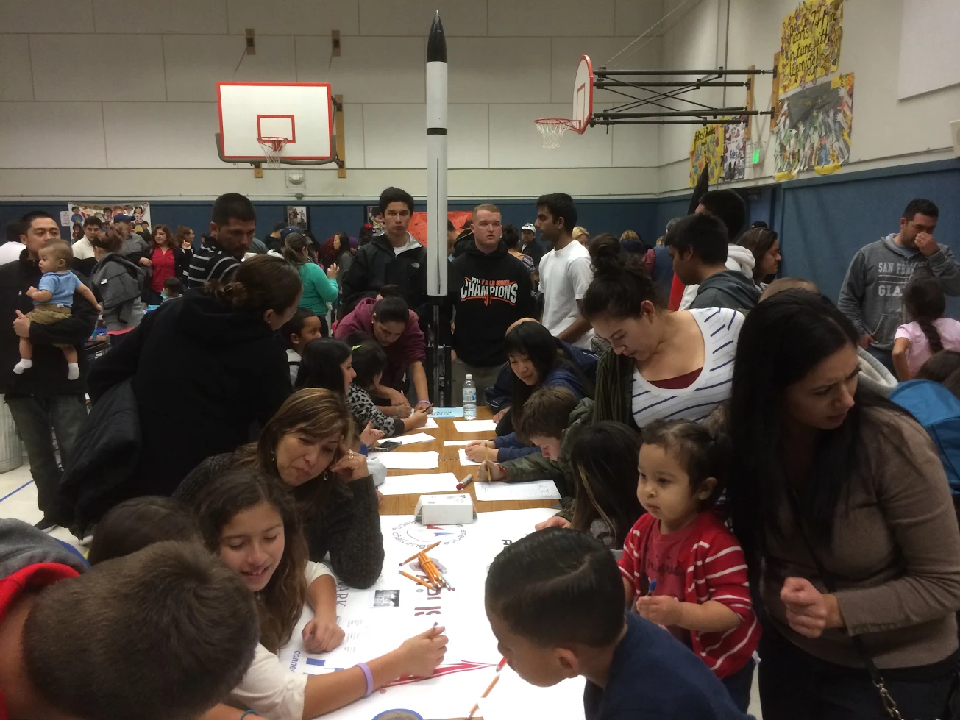
Community Outreach
Science In the Park
Elementary School Science Nights
Notes:
In October, our team attended the Science in the Park fair for Alameda County where we educated children about rocketry, demonstrating rocket launches every half hour.
We had booths set up displaying low power, mid power and high power rockets.
We taught the kids how to put an igniter into an engine, assemble a motor mount, set up a launch system, pack a parachute, and fire a rocket.
Our team had presented at a local elementary school educating young students about rocketry and how they can become involved in their junior high TARC team.
when we did the science night my group did these balloon-rocket races. we taped a balloon to string, and when we counted down from five the kids let go.
we also took our arliss rocket to are science nights like you see in the picture, and in the other science night picture Bryanna is showing the kids what is it the rocket and what its purpose is for.

